Slide 1
Unit 2
Basics of C++ programming

Slide 2
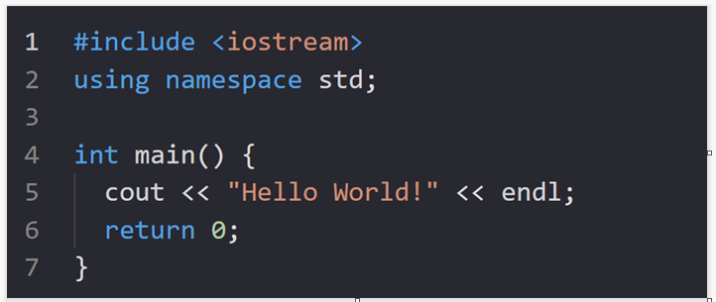
C++ Program Structure
A C++ program is structured in a specific and particular manner. In C++, a program is divided into the following three sections:
Standard Libraries Section
Main Function Section
Function Body Section

Slide 3
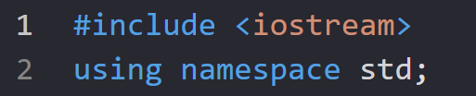
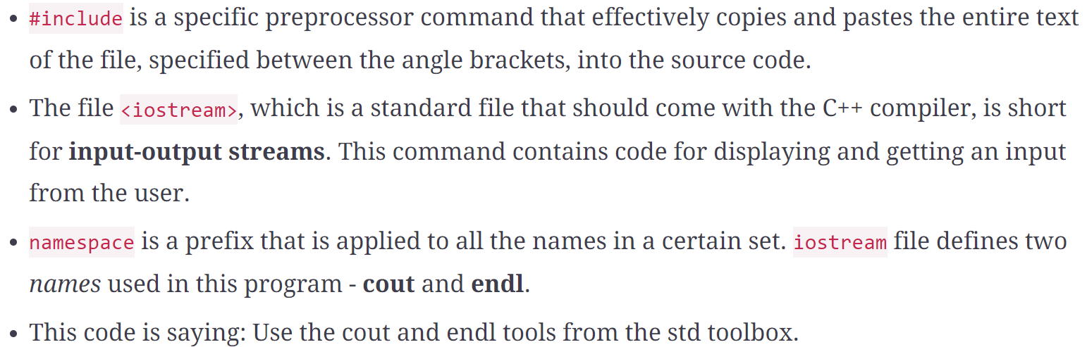
Standard libraries section

Slide 4
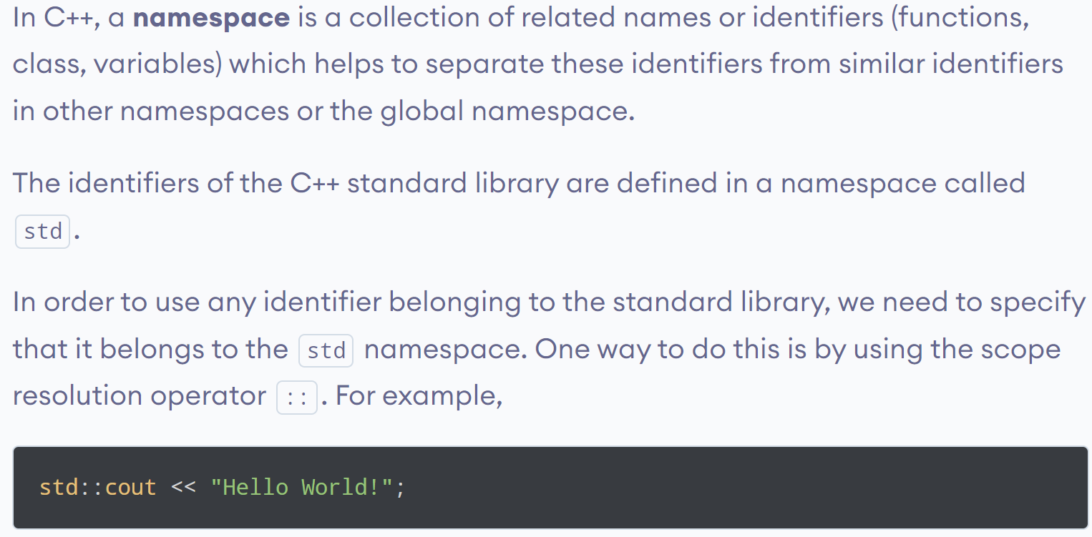
C++ Namespace

Slide 5
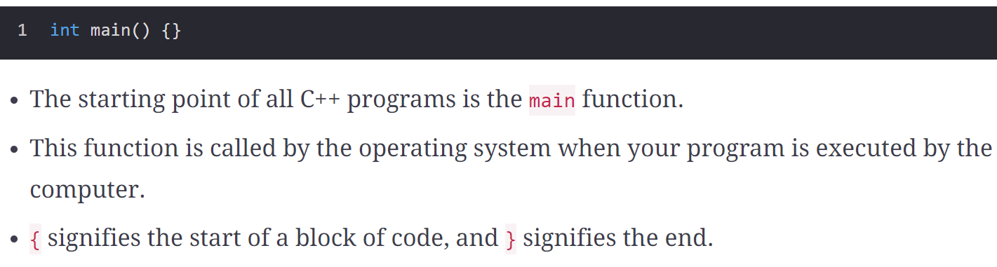
Main function section

Slide 6
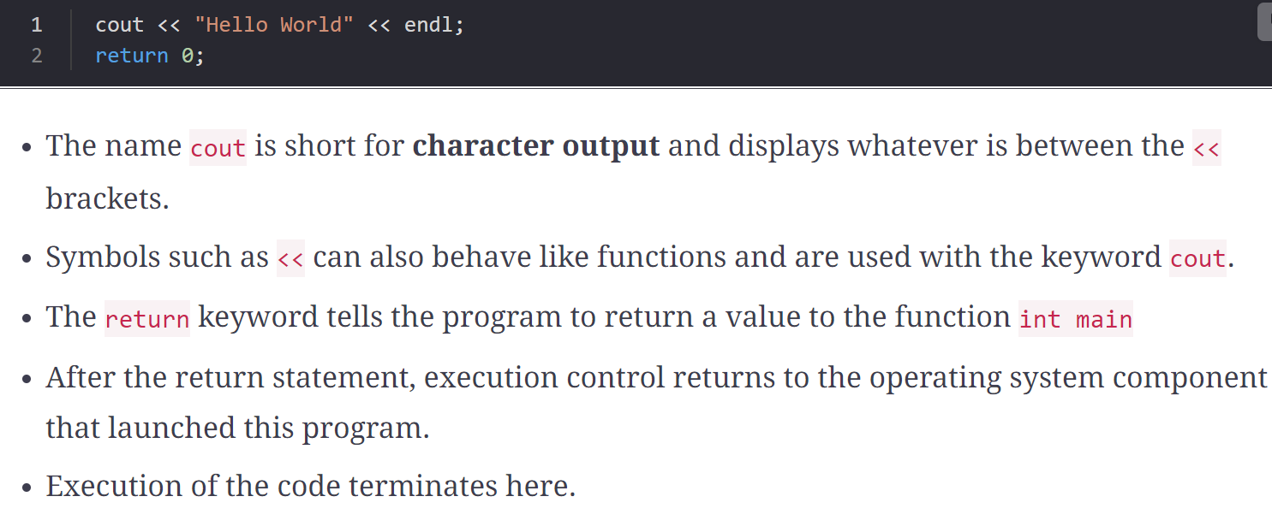
Function body section

Slide 7
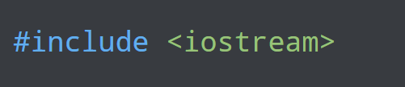
C++ Pre-processors
C++ pre-processors are tools that transform (pre-process) our program before it is compiled.
Pre-processors use pre-processor directives in order to control the code transformation. For example,

Slide 8
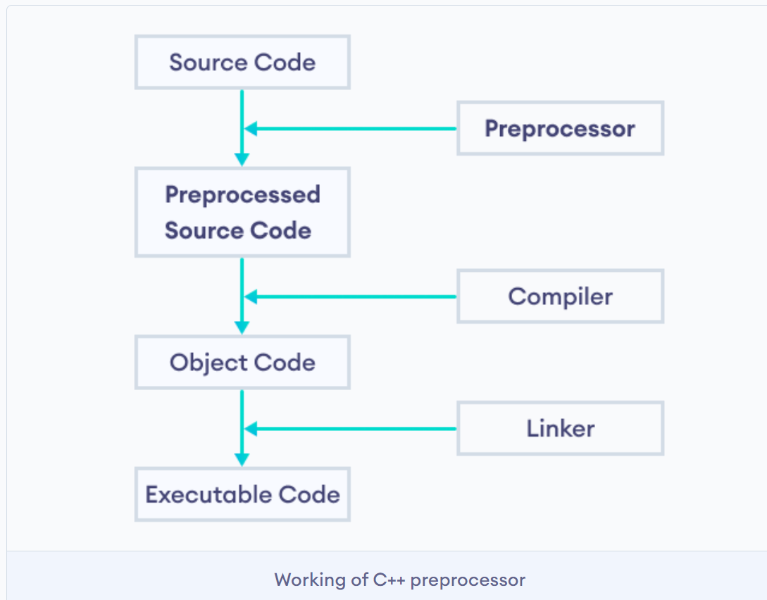

Slide 9
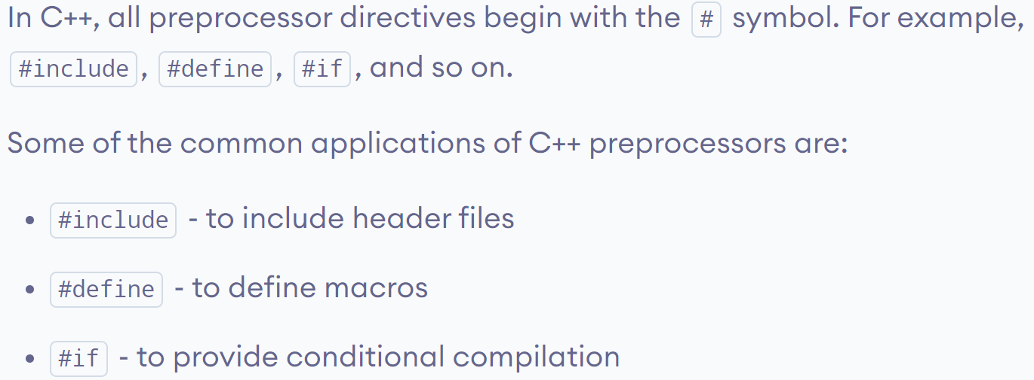
C++ Pre-processors Directives

Slide 10
C++ Character Set, Identifier, Keywords and Variables and Constants
Similar to C Programming

Slide 11
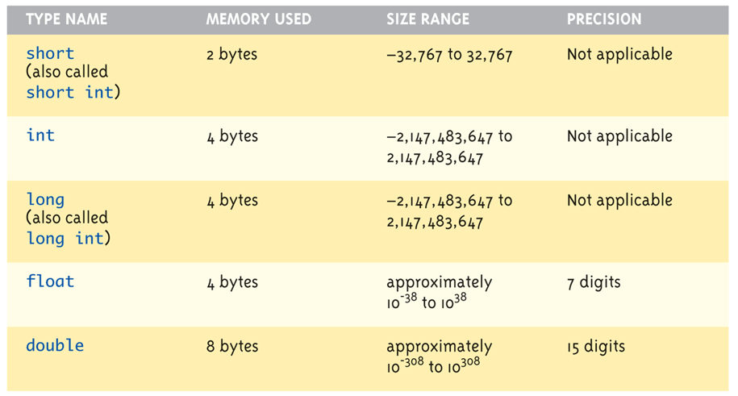
Data Types:

Slide 12
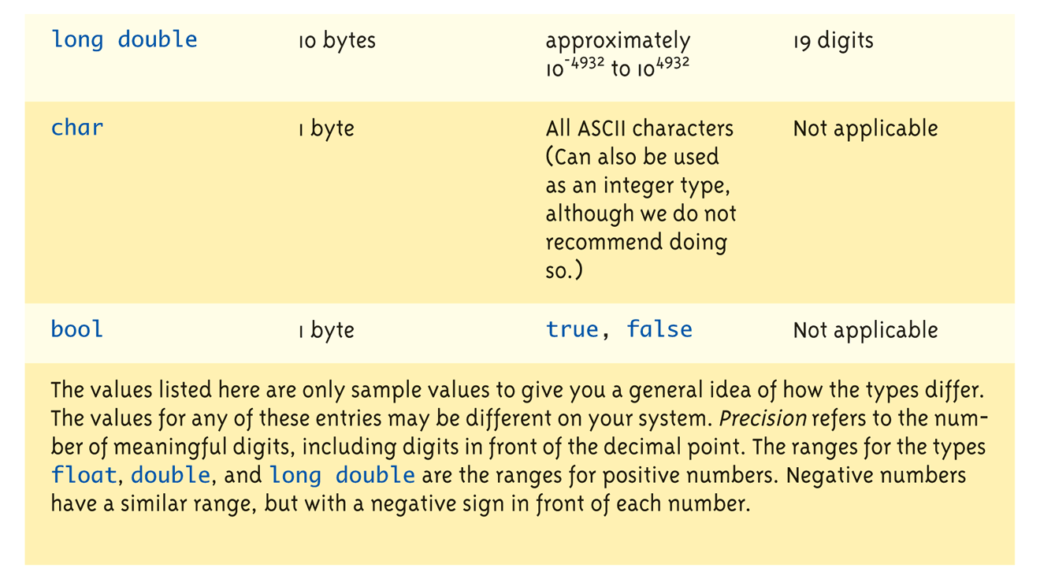
Data Types:

Slide 13
Assigning Data
Initializing data in declaration statement
Results "undefined" if you don’t!
int myValue = 0;
Assigning data during execution
Lvalues (left-side) & Rvalues (right-side)
Lvalues must be variables
Rvalues can be any expression
Example: distance = rate * time; Lvalue: "distance" Rvalue: "rate * time"

Slide 14
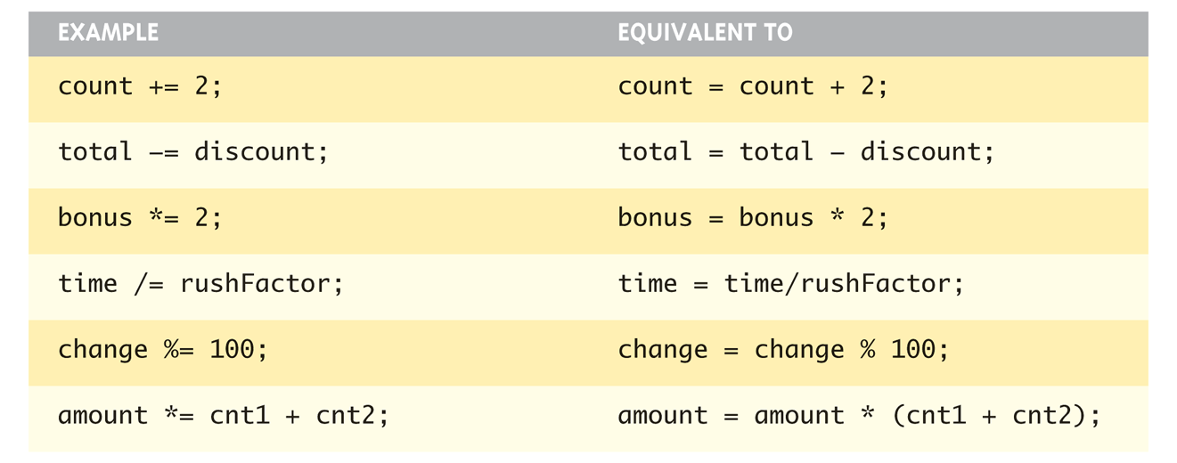
Assigning Data: Shorthand Notations

Slide 15
Data Assignment Rules
Compatibility of Data Assignments
Type mismatches
General Rule: Cannot place value of one type into variable of another type
intVar = 2.99; // 2 is assigned to intVar!
Only integer part "fits", so that’s all that goes
Called "implicit" or "automatic type conversion"
Literals
2, 5.75, "Z", "Hello World"
Considered "constants": can’t change in program

Slide 16
Literal Data
Literals
Examples:
2 // Literal constant int
5.75 // Literal constant double
"Z" // Literal constant char
"Hello World" // Literal constant string
Cannot change values during execution
Called "literals" because you "literally typed" them in your program!

Slide 17
Escape Sequences
"Extend" character set
Backslash, \ preceding a character
Instructs compiler: a special "escape character" is coming
Following character treated as "escape sequence char"
Display 1.3 next slide

Slide 18
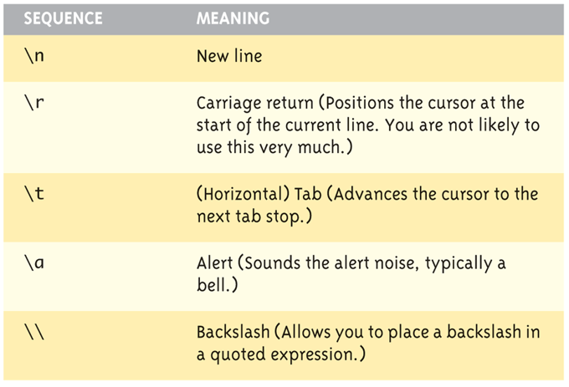
Escape Sequences Example

Slide 19
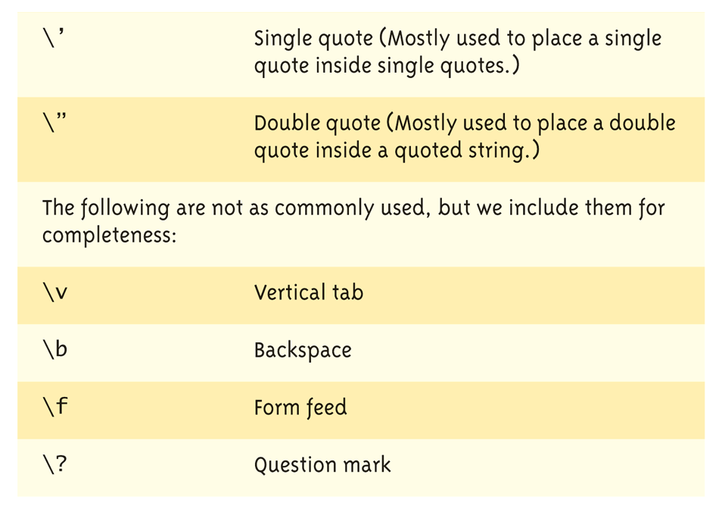
Escape Sequences Example

Slide 20
Type Casting
Two types
Implicit—also called "Automatic"
Done FOR you, automatically 17 / 5.5 This expression causes an "implicit type cast" to take place, casting the 17 → 17.0
Explicit type conversion
Programmer specifies conversion with cast operator (double)17 / 5.5 Same expression as above, using explicit cast (double)myInt / myDouble More typical use; cast operator on variable

Slide 21
Shorthand Operators
Increment & Decrement Operators
Just short-hand notation
Increment operator, ++ intVar++; is equivalent to intVar = intVar + 1;
Decrement operator, -- intVar--; is equivalent to intVar = intVar – 1;

Slide 22
Shorthand Operators: Two Options
Post-Increment intVar++
Uses current value of variable, THEN increments it
Pre-Increment ++intVar
Increments variable first, THEN uses new value
"Use" is defined as whatever "context" variable is currently in
No difference if "alone" in statement: intVar++; and ++intVar; → identical result

Slide 23
Post-Increment in Action
Post-Increment in Expressions: int n = 2, valueProduced; valueProduced = 2 * (n++); cout << valueProduced << endl; cout << n << endl;
This code segment produces the output: 4 3
Since post-increment was used

Slide 24
Pre-Increment in Action
Now using Pre-increment: int n = 2, valueProduced; valueProduced = 2 * (++n); cout << valueProduced << endl; cout << n << endl;
This code segment produces the output: 6 3
Because pre-increment was used

Slide 25
Console Input/Output
I/O objects cin, cout, cerr
Defined in the C++ library called <iostream>
Must have these lines (called pre- processor directives) near start of file:
#include <iostream> using namespace std;
Tells C++ to use appropriate library so we can use the I/O objects cin, cout, cerr

Slide 26
Console Output
What can be outputted?
Any data can be outputted to display screen
Variables
Constants
Literals
Expressions (which can include all of above)
cout << numberOfGames << " games played."; 2 values are outputted: "value" of variable numberOfGames, literal string " games played."
Cascading: multiple values in one cout

Slide 27
Separating Lines of Output
New lines in output
Recall: "\n" is escape sequence for the char "newline"
A second method: object endl
Examples:
cout << "Hello World\n";
Sends string "Hello World" to display, & escape sequence "\n", skipping to next line
cout << "Hello World" << endl;
Same result as above

Slide 28
Formatting Output
Formatting numeric values for output
Values may not display as you’d expect! cout << "The price is $" << price << endl;
If price (declared double) has value 78.5, you might get:
The price is $78.500000 or:
The price is $78.5
We must explicitly tell C++ how to output numbers in our programs!

Slide 29
Formatting Numbers
"Magic Formula" to force decimal sizes: cout.setf(ios::fixed); cout.setf(ios::showpoint); cout.precision(2);
These stmts force all future cout’ed values:
To have exactly two digits after the decimal place
Example: cout << "The price is $" << price << endl;
Now results in the following: The price is $78.50
Can modify precision "as you go" as well!

Slide 30
Formatting Output
The endl manipulator causes a linefeed to be inserted into the stream, so that subsequent text is displayed on the next line. It has same effect as sending the ‘\n’ character.
Example:
cout << endl<< "Perimeter is " << perimeter; cout << endl << "Area is " << area << endl;

Slide 31
Formatting Output
The setw Manupulator: To use setw manipulator the “iomanip.h” header file must be included. The setw manipulator causes the number or string that follows it in the stream to be printed within a field n characters wide , where n is the argument used with setw as stew(n). The value is right justified within the field.

Slide 32
//demonstrates setw manipulator
#include<iostream.h>
#include<iomanip.h>
void main() { long pop1=5425678,
pop2=47000;
pop3=76890;
cout<<setw(8)<<”LOCATION”<<setw(12)<< “POPULATION”<<endl <<setw(8)<< “Patan”<<setw(12)<<pop1<<endl
<<setw(8)<< “Khotang” <<setw(12)<<pop2<<endl
<<setw(8)<< “Butwal” <<setw(12) <<pop3<<endl;
}
The output of this program is:LOCATION POPULATION Patan 5425678 Khotang 47000 Butwal 76890

Slide 33
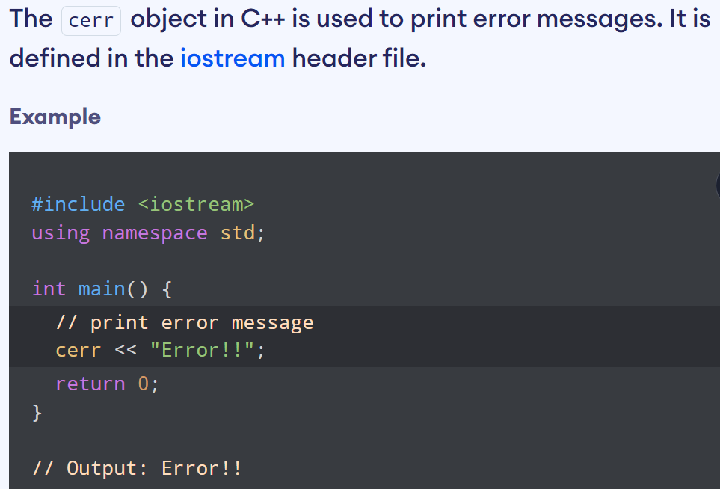
Error Output

Slide 34
Input Using cin
cin for input, cout for output
Differences:
">>" (extraction operator) points opposite
Think of it as "pointing toward where the data goes"
Object name "cin" used instead of "cout"
No literals allowed for cin
Must input "to a variable"
cin >> num;
Waits on-screen for keyboard entry
Value entered at keyboard is "assigned" to num

Slide 35
Prompting for Input: cin and cout
Always "prompt" user for input cout << "Enter number of dragons: "; cin >> numOfDragons;
Note no "\n" in cout. Prompt "waits" on same line for keyboard input as follows:
Enter number of dragons: ____
Underscore above denotes where keyboard entry is made
Every cin should have cout prompt
Maximizes user-friendly input/output

Slide 36
Variable Definition at the point of use
In C, local variables can only be defined at the top of a function, or at the beginning of a nested block. In C++, local variables can be created at any position in the code, even between statements. Also local variables can be defined in some statements, just before their usage.
//to find sum of first natural number to display for loop
#include<iostream>
int main()
{
int n;
cout<<"\nEnter Number";
cin>>n;
int sum=0;
for( int i=0;i<=n;i++)
sum+=i;
cout<<"Sum of first n natural number:"<<sum;
return 0;
}
Values can be given to variables by the assignment statement

Slide 37
Scope Resolution Operator (::)
C++ supports a mechanism to access a global variable from a function in which a local variable is defined with the same name as a global variable. It is achieved using the scope resolution operator.
:: GloabalVariableName
The global variable to be accessed must be preceded by the scope resolution operator. It directs the compiler to access a global variable, instead of one defined as a local variable.

Slide 38
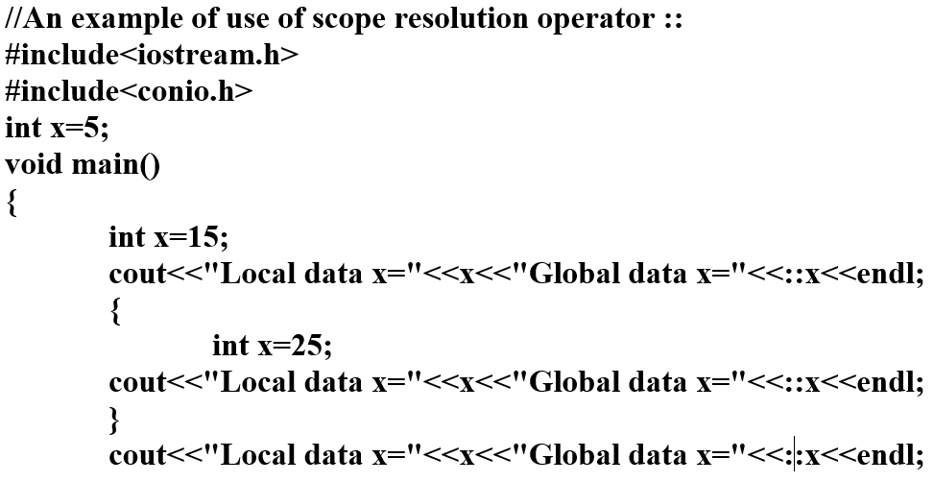
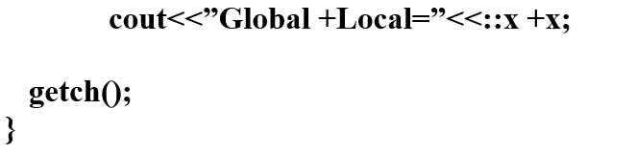

Slide 39
Reference Variables
A reference variable provides an alias (Alternative name) of the variable that is previously defined. For example, if we make the variable sum a reference to the variable total, the sum and total can be used interchangeably to represent that variable.
Syntax for defining reference variable
Data_type & reference_name = variable_nane

Slide 40
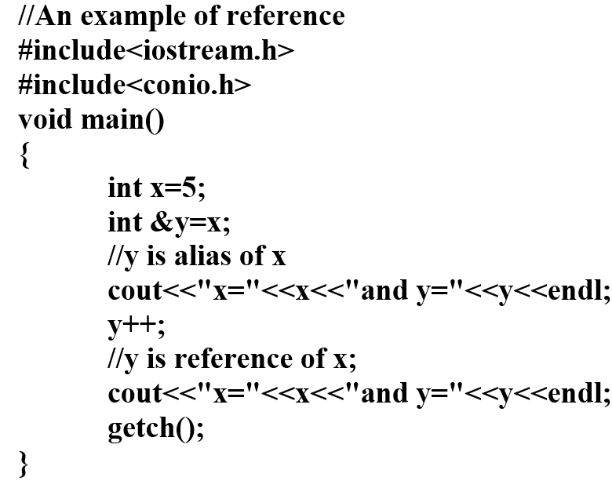
Example: Reference Variable

Slide 41
Passing by reference
We can pass parameters in function in C++ by reference.
When we pass arguments by reference, the formal arguments in the called function become aliases to the actual arguments in the calling function i.e. when function is working with its own arguments , it is actually working on the original data.

Slide 42
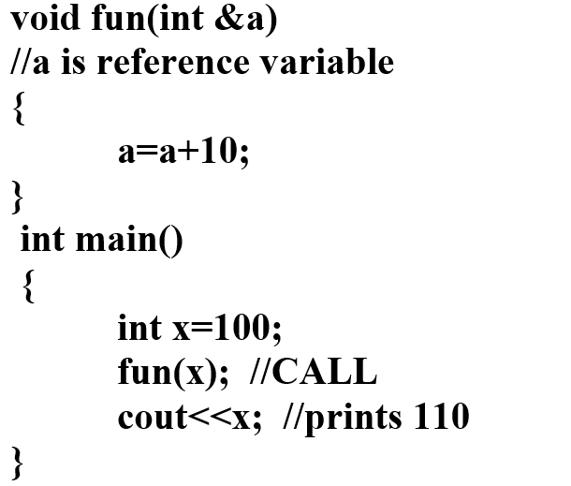
Example: Passing by Reference

Slide 43
Return by reference
A function can return a value by reference.
This is a unique feature of C++.
Normally function is invoked only on the right hand side of the equal sign.
But we can use it on the left side of equal sign and the value returned is put on the right side.

Slide 44
Example: Return by Reference
//returning by reference from a function as a parameter
#include<iostream>
int x=5,y=15;//globel variable
int &setx();
void main()
{
setx()=y;
//assign value of y to the variablereturned by the function
cout<<"x="<<x<<endl;
return 0;
}
int &setx()
{
//display global value of x
cout<<"x="<<x<<endl;
return x;
}

Slide 45
Inline Function
A inline function is a short-code function written and placed before main function and compiled as inline code. The prototyping is not required for inline function.
It starts with keyword inline. In ordinary functions, when function is invoked the control is passed to the calling function and after executing the function the control is passed back to the calling program.
But, when inline function is called, the inline code of the function is inserted at the place of call and compiled with the other source code together.

Slide 46
Example: Inline Function
// Inline function saves memory, the call to function cause the same code to be
//executed;the function need not be duplicated in memory
#include<iostream>
inline float lbstokg(float pound)
{
return (0.453592*pound);
}
void main()
{
float lbs1=50,lbs2=100;
cout<<"Weinght in Kg:"<<lbstokg(lbs1)<<endl;
cout<<"Weinght in Kg:"<<lbstokg(lbs2)<<endl;
}

Slide 47
Default Arguments

Slide 48
Constant Arguments

